Slide 1


Sovereign Bank Governance and Release strategy
Vaibhav Maheshwari
Architect @ServiceWow
ServiceWow
Notes:
Hello, my name is Vaibhav Maheshwari, it’s a pleasure to be here, bringing solutions

Slide 2
Governance
Agile Framework
Instance Structure
Release Strategy
Key Takeaways
Agenda

Slide 3

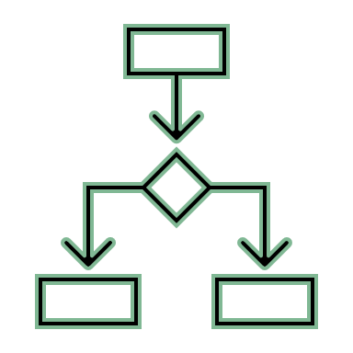
What is governance?
Governance is a decision-making framework that
accelerates outcomes by defining:
What
decision need to
be made and when
Who
is involved in
decision-making
How
decision
are made

Slide 4



Why invest in governance?
Drive your transformation vision
by aligning all ServiceNow investment to support strategy.
Deliver the right work at the right time
by streamlining decisions and removing roadblocks.
Maintain the integrity of your ServiceNow implementation
by defining and applying the technical best practices.
Notes:
Drive your transformation vision
Establish a Technical Governance Board to align all ServiceNow investments with the bank’s strategic goals.
Example: Instead of customizing ServiceNow to fit old Remedy processes, governance ensures that processes are standardized to align with ServiceNow best practices and long-term scalability.
Deliver the right work at the right time
Implement an incremental release strategy (phased rollouts) to avoid bottlenecks and misalignment.
Example: Instead of launching ITSM, ITOM, and HR all at once, governance mandates a staggered rollout—first focusing on ITSM & CMDB, followed by ITOM & CSM, ensuring each phase is optimized before moving to the next.
Maintain the integrity of your ServiceNow implementation
Enforce strict platform guardrails to prevent unnecessary customizations that may lead to technical debt.
Example: Governance policies define customization limits (e.g., prioritizing configuration over scripting), ensuring the platform remains upgradeable and compliant with financial regulations.

Slide 5
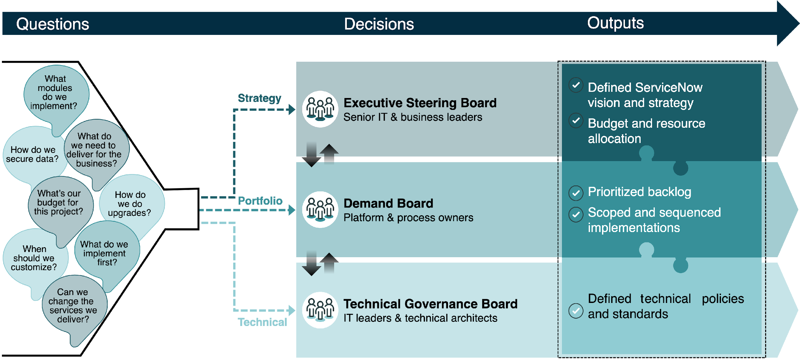
Governance process and Board structure

Slide 6
Key Governance Roles
Governance setup role(s) (e.g., platform owner)
• Sets up governance committee structure
• Coordinates governance decision-making processes
• Documents and updates governance policy and process
• Collaborates with enterprise process functions
ServiceNow executive sponsor
ServiceNow platform team
IT/ Domain leaders
Service owners and Process owners
Program managers (PMO)
Enterprise architects or platform architects
Information security team

Slide 7
Drive your transformation vision
What
Who
How
Decision
Standardize configuration vs. customization to align with long-term scalability
Timing
Before major implementations begin (pre-ITSM rollout)
Technical Governance Board
(Enterprise Architect, Platform Owner, IT Operations)
Business Leaders
(Risk & Compliance, Service Owners)
Governance Board establishes
guardrails
Approval process is
implemented

Slide 8
Deliver the Right Work at the Right Time
What
Who
How
Decision
Implement ITSM (incident, problem, change) first, then move to ITOM (discovery, automation)
Timing
During the roadmap planning phase (before implementation sprints begin)
Enterprise Architect - (Li Na) ensures the phased approach aligns with architecture principles
ServiceNow Product Owner - (Albert Wan) prioritizes based on business urgency
ITSM & ITOM Process Owners validate dependencies and readiness
Governance Board reviews dependencies
Risk assessment & backlog prioritization
Confidential | @2025 ServiceWow. All Rights Reserved

Slide 9
Maintain the Integrity of Your ServiceNow Implementation
What
Who
How
Decision
Define instance strategy (Dev, Test, UAT, Production)
and control who can modify production
Timing
Before development begins and continuously enforced
Platform Owner (Albert Wan) owns the instance management process
Change Advisory Board (CAB) approves production changes
Security & Compliance Teams ensure changes comply with financial regulations
Strict governance policy applied
CAB reviews major changes to ensure they follow best practices
Confidential | @2025 ServiceWow. All Rights Reserved

Slide 10
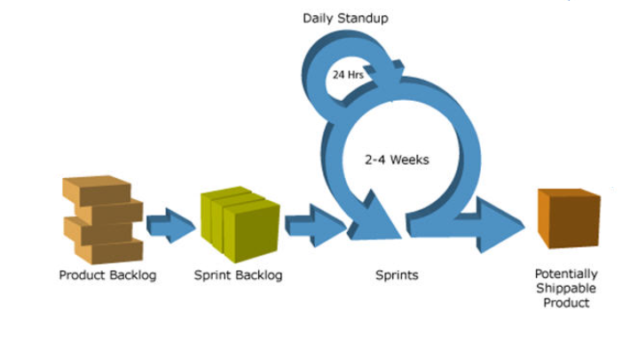
Agile Framework: Hybrid
Waterfall
Agile Scrum
Waterfall
Demand
Gather Requirements
UAT Instance
Production Instance
General Conception
Maintenance Support
Global Plan

Slide 11
Instance Structure
Prod Support / Training
Update Set(s)
Test/ QA
2
UAT
4
Update Set(s)
Update Set(s)
1
3
Development
Production
Clone
Clone
Update Set(s) migration

Slide 12
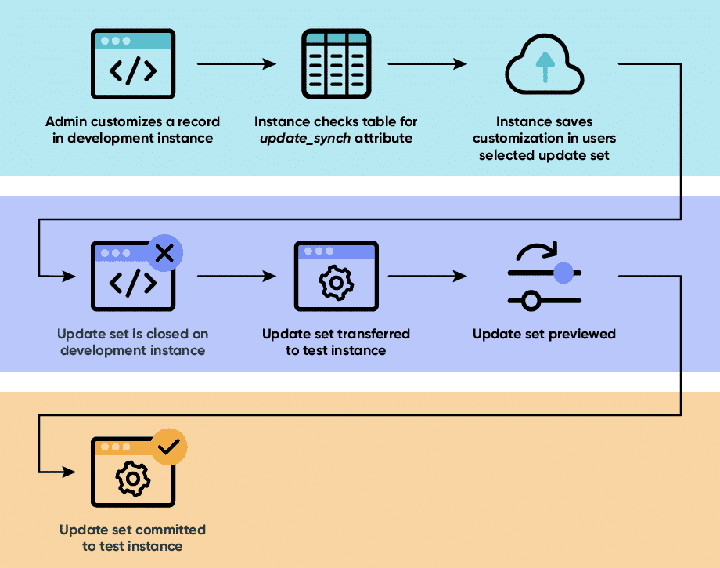
Release Strategy

Slide 13



Key Takeaways
IMPORTANCE OF SERVICENOW GOVERNANCE
SCALABLE AND SUSTAINABLE AGILE FRAMEWORK
INSTANCE STRUCTURE AND ROBUST RELEASE STRATEGY

Slide 14




Thank you
www.servicewow-consultancy.com

